Slide 1
LAKE SHERWOOD ACRES
Our Next Chapter
What we heard, and the plan that came from it.
Neighborhood Follow-Up Meeting · October 28th, 2026 · Lake Sherwood Clubhouse
Notes:
Thank everyone for coming back. Remind the room that the Vision Meeting on September 30th was a conversation, and tonight is the follow-up: here is what changed because of what you told us. Nothing is being voted on tonight.

Slide 2
Why we're here tonight
1
We listened at the Vision Meeting, and the plan changed because of it.
2
Tonight: a new idea for the courts and the final proposed dues.
3
Everything is still voted on. Nothing is final until the neighborhood decides.
Notes:
Same promise as last time, said again on purpose. Read the third line out loud. The biggest thing people will want to hear is that the plan moved in response to them, so lead with that and point to the two changes coming up: the courts and the dues.

Slide 3
Tennis courts: no clear winner
What would you like to see happen to the tennis courts in the neighborhood?
56% want to keep courts in some form; 44% would replace them with sod or do nothing
KEEP AS COURTS (ANY OPTION)
56% 54 votes
REMOVE FOR SOD or DO NOTHING
44% 43 votes
Source: Lake Sherwood Acres neighborhood interest survey (Google Form), 97 responses. Pickleball appears in 52% of choices.
Notes:
This is the slide from the Vision Meeting that started the change. The courts were the one place the neighborhood truly split: 56% wanted courts in some form, 44% wanted them gone or left alone, and no single option won a majority. Spending $195,000 on a choice that divided the room did not sit right with the board. That is what led to the next idea.

Slide 4
+ PLUS +
Nobody really has the appetite to pay for it right now
Notes:
This is the slide from the Vision Meeting that started the change. The courts were the one place the neighborhood truly split: 56% wanted courts in some form, 44% wanted them gone or left alone, and no single option won a majority. Spending $195,000 on a choice that divided the room did not sit right with the board. That is what led to the next idea.

Slide 5
LAKE SHERWOOD ACRES
The Courts, Reimagined
A community garden and game area for everyone.
Neighborhood Follow-Up Meeting · October 28th, 2026 · Lake Sherwood Clubhouse
Notes:
Transition: here is what the board is proposing for the courts instead of a full rebuild or a full removal.

Slide 6
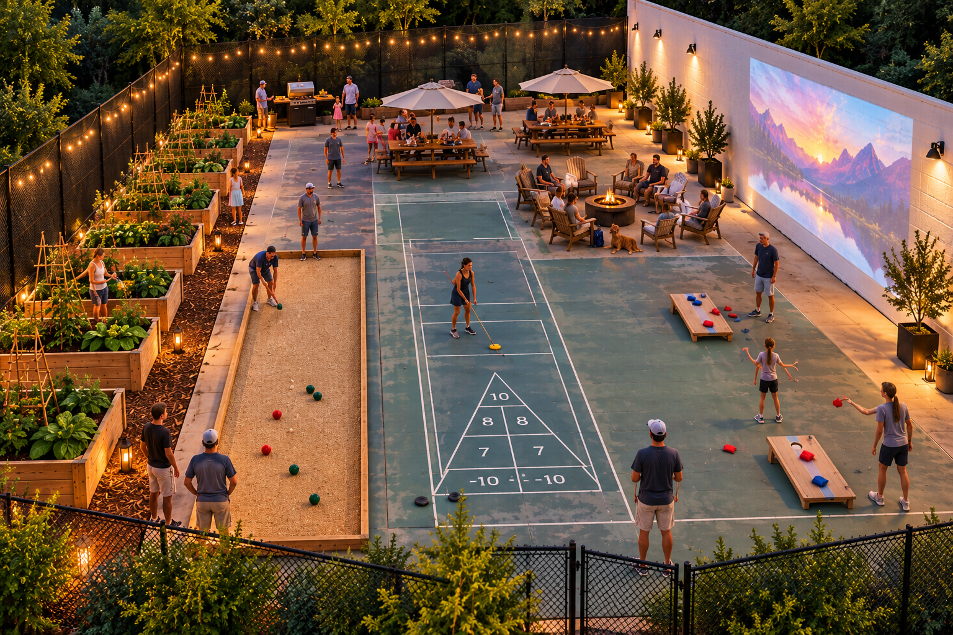
A community garden and game area
WHAT'S IN IT
Raised garden beds for neighbors to rent and grow whatever legal plant they want
Cornhole and other community type games on the existing court surface
Outdoor movie nights on the back wall
Fence and electrical repair.
WHY THIS APPROACH
It puts the space to use now, for far less than a rebuild or a demolition with landscaping and a resod without ruling out courts in the future.
Concept rendering.
Notes:
Walk through the rendering from left to right: garden beds, bocce, shuffleboard and cornhole painted or set on the existing court surface, the patio and grill along the back, and the wall for movie nights. Stress the middle ground: this is not a $195,000 rebuild and it is not tearing the courts out. It uses what is already there and keeps the decision open. If the neighborhood later wants pickleball or tennis, nothing here prevents it. The rendering is a concept; say so.

Slide 7
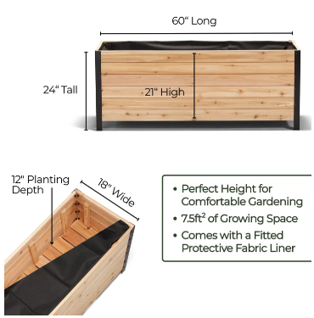
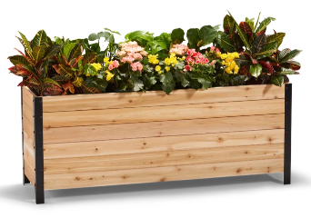
Raised beds that neighbors can rent for the growing season
60″ × 18″
21″
footprint of each bed
tall, so no kneeling
12″
7.5 sq ft
deep planting soil
of growing space per bed
Cedar boxes with a fitted fabric liner. Simple enough for a volunteer workday, and easy to add more as interest grows.
Notes:
These are the planter boxes being considered. The standing height matters: at about 21 inches to the soil, most neighbors can garden without kneeling, which opens the garden up to older residents and anyone with limited mobility. They are cedar with a fabric liner and can be assembled at a volunteer workday. Start with a handful and add more if demand is there.

Slide 8
Where the Garden Boxes come from?
Boy Scout Eagle Projects – Zero Cost to the Neighborhood.
Neighbors can either build or buy a box and donate it to the neighborhood.
-- First year is free for your use if you do this.
-- Must have plans approved first!
Club can provide if they vote to utilize their funds for this purpose.
Notes:
These are the planter boxes being considered. The standing height matters: at about 21 inches to the soil, most neighbors can garden without kneeling, which opens the garden up to older residents and anyone with limited mobility. They are cedar with a fabric liner and can be assembled at a volunteer workday. Start with a handful and add more if demand is there.

Slide 9
Other Zones and Miscellaneous Improvements
Everything in the photo is designed to be handled as a mini project with
the movie wall and garden area being the top priority as those will be the
quickest and easiest improvements to make per unit of enjoyment.
Bocci area, shuffle board, firepit, picknick table area, and other aesthetic
improvements can be added over time in stages.
Notes:
These are the planter boxes being considered. The standing height matters: at about 21 inches to the soil, most neighbors can garden without kneeling, which opens the garden up to older residents and anyone with limited mobility. They are cedar with a fabric liner and can be assembled at a volunteer workday. Start with a handful and add more if demand is there.

Slide 10
LAKE SHERWOOD ACRES
The Final Numbers
Proposed dues, revised after your feedback.
Neighborhood Follow-Up Meeting · October 28th, 2026 · Lake Sherwood Clubhouse
Notes:
Transition to dues. Say plainly that these are the final proposed numbers that will go to a vote.

Slide 11
Six assets, one big change
Project | What it covers | Estimate | Phase
Courts → Community area | Convert to a community garden and game area on the existing court surface. No full rebuild. Replenish reserves | $25,000 (was $195,000 rebuild) | [1]
Clubhouse | ADA compliant facilities and modern updates. | *$68,000 | [1], [2]
Lake maintenance | Trash prevention, restore/replace fountains, add aeration, fish habitats, Replenish reserves | $19,736 year one | [1], [2]
Pool | Replaster (In TWO years) and other repairs and leak mitigation, Replenish reserves | *$50,000 per year, restore in two years | [2]
Grounds | No Special Projects Planned | $24,578 | [Ongoing]
Security | This budget has worked for over 18 years | $32,400 annually | [Ongoing]
*Estimates are preliminary. Firm bids will be obtained before any a vote to allocate funds to any new construction project.
Notes:
This is the same table from the Vision Meeting with one change: the top line. The $195,000 court replacement is replaced by the community area. Its cost is still being finalized, so say that rather than guessing. Everything else carries over as presented in September.

Slide 12
What this means for each household
OFF LAKE
ON LAKE
PER MONTH
$755
$1,050
+$18.58 / +$15.67
per year, up from $532
per year, up from $862
off lake / on lake vs. today
SINCE SEPTEMBER
That is $240 less off lake and $251 less on lake than the $995 / $1,301 shown at the Vision Meeting. The biggest change: the courts become a community area instead of a $195,000 rebuild.
Notes:
Say the two annual numbers clearly: $750 off lake, $1,050 on lake. Then the monthly version, because that is how most people decide: about $18 a month more off lake and about $16 a month more on lake than today ($218 and $188 a year). Then the comparison to September: $245 and $251 a year less than what was shown at the Vision Meeting. Confirm before the meeting that the courts change is the main driver of the reduction and name any other changes the board made.

Slide 13
What dues cover now, and what they would cover
TODAY (OFF LAKE / ON LAKE)
PROPOSED (OFF LAKE / ON LAKE)
$532 / $862
$755 / $1,050
Day-to-day operation of the pool and clubhouse
Routine grounds and entrance upkeep
Insurance and administration
Current security arrangement
Minor repairs as they come up
Everything as of today, uninterrupted
Courts turned into a community garden and game area
Needed clubhouse upgrades, including ADA facilities
Funded reserves, so future repairs are not a crisis
Lake Improvements
Notes:
Left side is what today's dues already cover. Right side is what the proposed dues add. The last line is still the most important: a funded reserve is what keeps this from turning into a special assessment later.

Slide 14
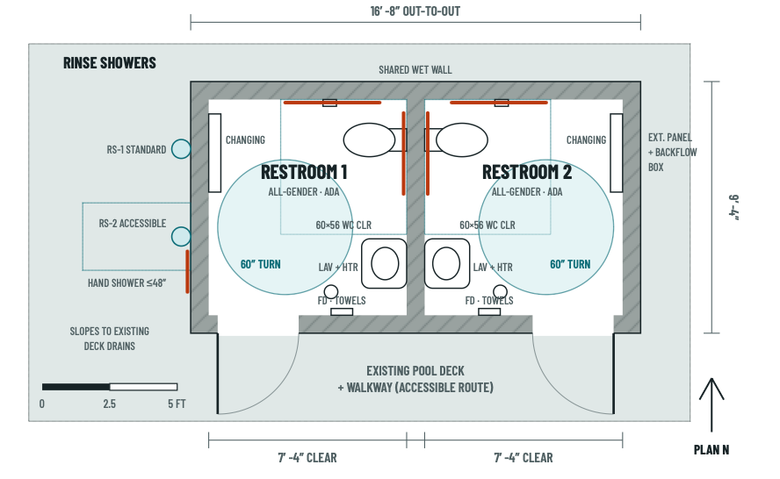
Pool restrooms: an ADA plan in progress
THE CONCEPT
Two single-user, all-gender ADA restrooms
Toilet, sink and baby changing station in each
Two rinse showers on the outside wall, one accessible
Built to access from the existing pool deck without having to enter the clubhouse.
Notes:
This answers the 78% who supported ADA upgrades in the survey. The current concept is two single-user, all-gender ADA restrooms on the pool deck, each with a toilet, sink and changing station, plus two rinse showers on the outside wall, one with an accessible hand shower. Do not quote a cost tonight; say that bids are being gathered and the number will be shared before any vote.

Slide 15
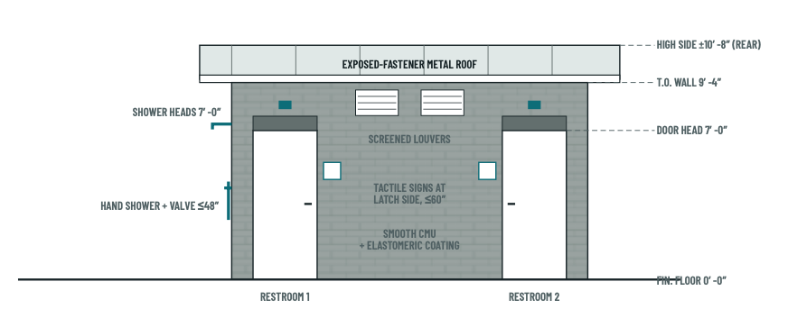
Pool restrooms: what it looks like
Front elevation, door side. Block walls, metal roof, screened vents, showers on the end wall.
Notes:
The front of the building as it would face the pool deck: two doors, tactile signs, a simple metal roof, and the showers on the left end wall at standing and seated heights.

Slide 16

Wanted: a few good neighbors
Retired, semi-retired or just generous with a few hours? We need you.
Help build the community garden and game area
Keep an eye neighborhood, lake, and grounds
Join a committee, or just help when you can
-- Covenant Review Committee
-- Social Events (Halloween porch crawl)
-- Neighborhood Welcome and Outreach
-- Newsletter
-- Licensed Electrician?
TO VOLUNTEER
Email council@lakesherwoodacres.com or sign up at the table tonight.
Notes:
Have some fun with this one. The poster is tongue in cheek, but the need is real: the community area only works if neighbors build the beds and keep it up, and every committee still has open seats. Point people to the sign-up sheet.

Slide 17
Many hands, lighter work
A plan this size needs more neighbors at the table.
COMMITTEES
BOARD OF DIRECTORS and COMMITTEE
Lake
Pool
Clubhouse
Open seats on the board
Debris removal, fountains, fish habitat and water quality.
Repairs, opening and closing, and summer upkeep.
Maintenance, rentals, and planning the renovation.
Help set the budget, oversee contractors, and bring each phase of the plan to fruition.
Community Area
Security
Council
Commitment
Monthly meetings and getting your hands dirty from time to time.
Build the beds, plan the games and keep the space tidy.
Work with our security provider and neighbors on safety.
Overseeing architecture compliance and policy violations
No experience needed, just a few hours and a love for this neighborhood.
Sign up at the table tonight, or email info@lakesherwoodacres.com
Notes:
Same committee structure as September, with the Courts committee now focused on the community area. Fill in the number of open board seats before the meeting.

Slide 18
What happens next
TONIGHT
BEFORE THE VOTE
DECEMBER
JANUARY
We walk through the revised plan and take your questions.
Final budget circulated for review.
You get to vote on the budget and HOA board members.
If budget passes the new board members get to work.
If proposed budget fails, 2026 budget is reused and things continue as they have been.
Tell us what you think before then
Comment cards are on the table tonight. After that, email: info@lakesherwoodacres.com or attend additional meetings
Notes:
Confirm the timeline before the meeting. The Vision Meeting said the final budget would circulate in December and the vote would be in January; update the cards if those dates have moved. Make sure comment cards are on the table.

Slide 19
LAKE SHERWOOD ACRES
We would rather hear it now than after the vote
Nothing is final until the neighborhood votes.
Tell us what we got wrong and what we missed.
Email Comment or Concerns to: info@lakesherwoodacres.com
Notes:
End on the invitation. Then take questions for as long as they last.

